Slide 1

Restaurant Recommendation Using Yelp Reviews
Kausar Perveen | Sohan Puthran| Shouvik Sharma| Rahul Nair | Cheng Jiang

Slide 2
Agenda
Problem Statement
Datasets
Exploratory Data Analysis
Data Preparation & Data Cleaning
Models
Deployment
Lessons Learned
Challenges
Future Plans
Questions

Slide 3
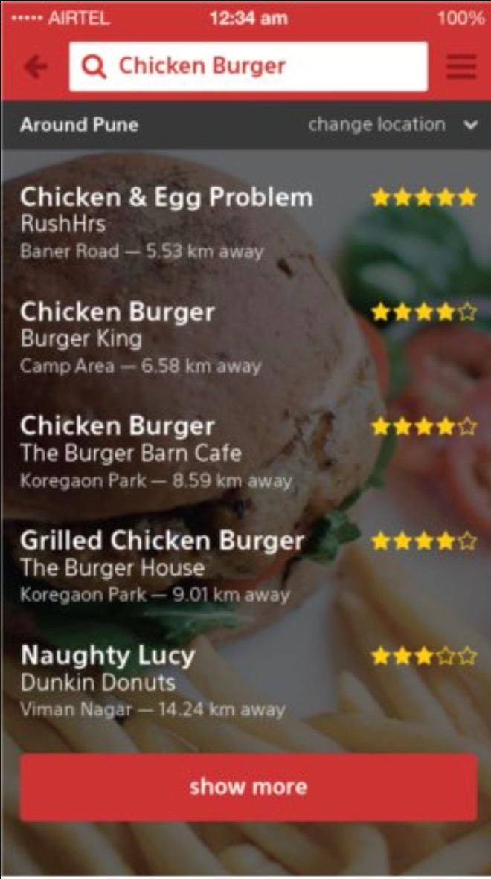
Problem & Vision
In terms of restaurants, there are too many options available for people to choose from based on their preferences.
It's always difficult for new visitors, even locals, to find the ideal restaurants that are exciting and novelty.
We aim to build a personalized prototype of restaurant recommendation system, which not only considers the interaction between customers and restaurants, but also contains metadata representing customers' personal taste and restaurant functions.

Slide 4
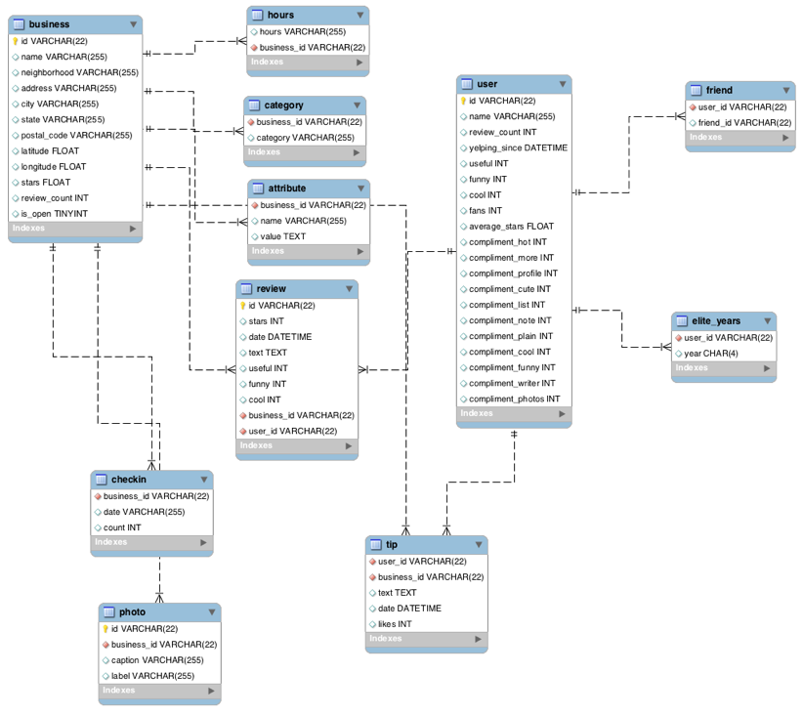
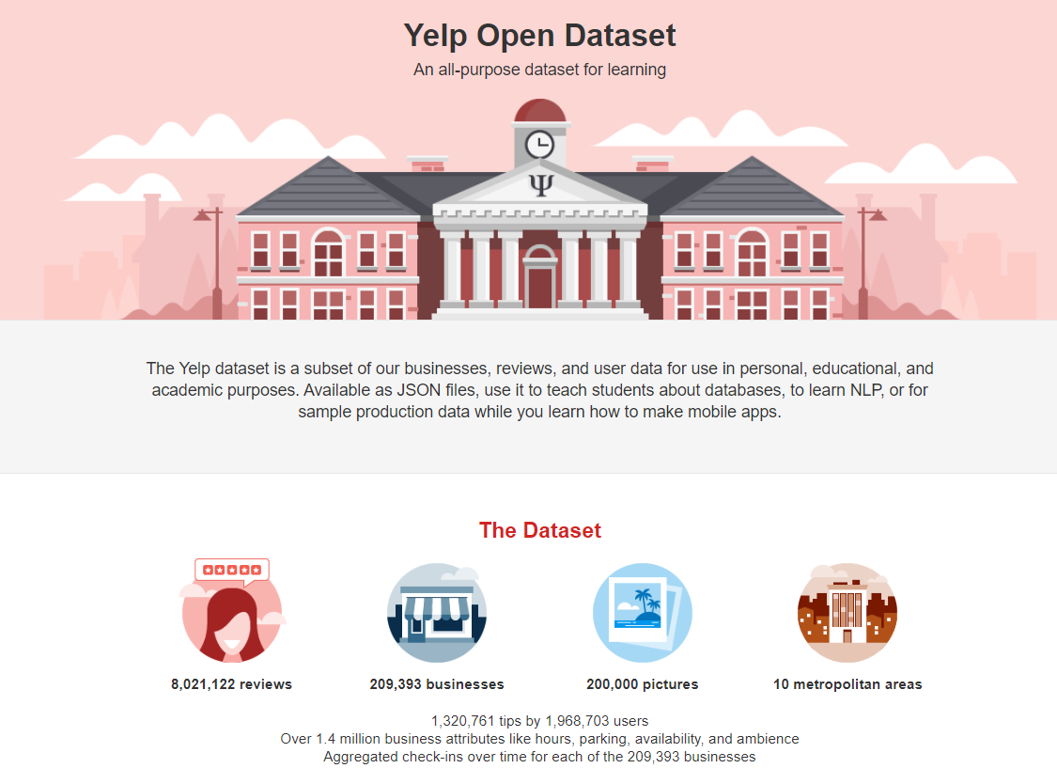
Datasets
Primary Dataset :-
Datasets are acquired from the official website of yelp
We are using following datasets :-
User.json
Review.json
Business.json
Secondary Dataset :-
We have acquired median income for each zipcode for the year 2019, and mapped to restaurants

Slide 5
Exploratory Data Analysis
Dataset Business contains geographical information about 192,609 businesses, categories and attributes, such as average star rating, hours, whether they offer parking etc.
Dataset review includes 6,685,900 review texts and ratings users write to businesses.
Dataset user includes information like how long ago the user has joined Yelp, the number of reviews he/she has written, the number of specific compliments received, and his/her friend mapping on Yelp about 1,637,138 users.
The three datasets can be merged by unique keys user_id and business_id.
Data was loaded using json library in python

Slide 6
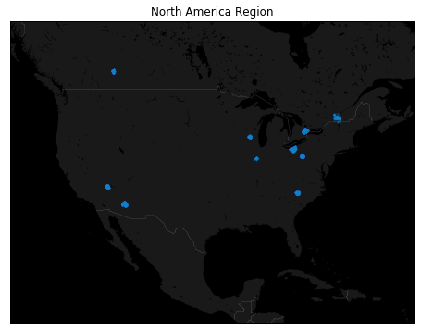
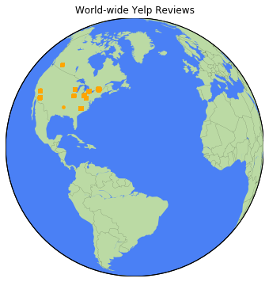
Exploratory Data Analysis
Business:
Yelp Business dataset is majorly spread across Northern America

Slide 7
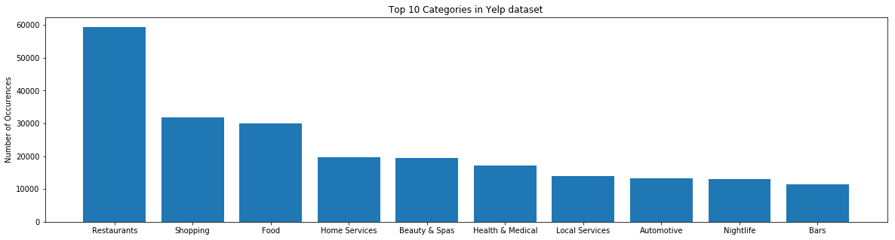
Exploratory Data Analysis
Business:
The yelp business dataset consists of variety of different businesses indicated by the column ‘attributes’
Number of entries for the category ‘Restaurants’ was the highest.
Notes:
Mention that ### There are 1301 categories. We shall check top 10 categories.

Slide 8
Exploratory Data Analysis
Users:
From the correlation matrix, we observe that there exists high correlation between variables due to multi-component ratings
USERS CORRELATION MATRIX

Slide 9
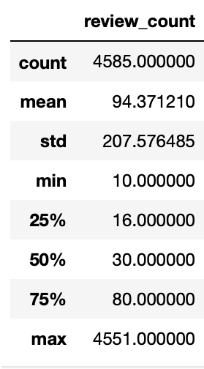
Exploratory Data Analysis
Users:
There are outliers observed in the value of review_count in the user's dataset
Notes:
Whether it is Illinois specific?

Slide 10
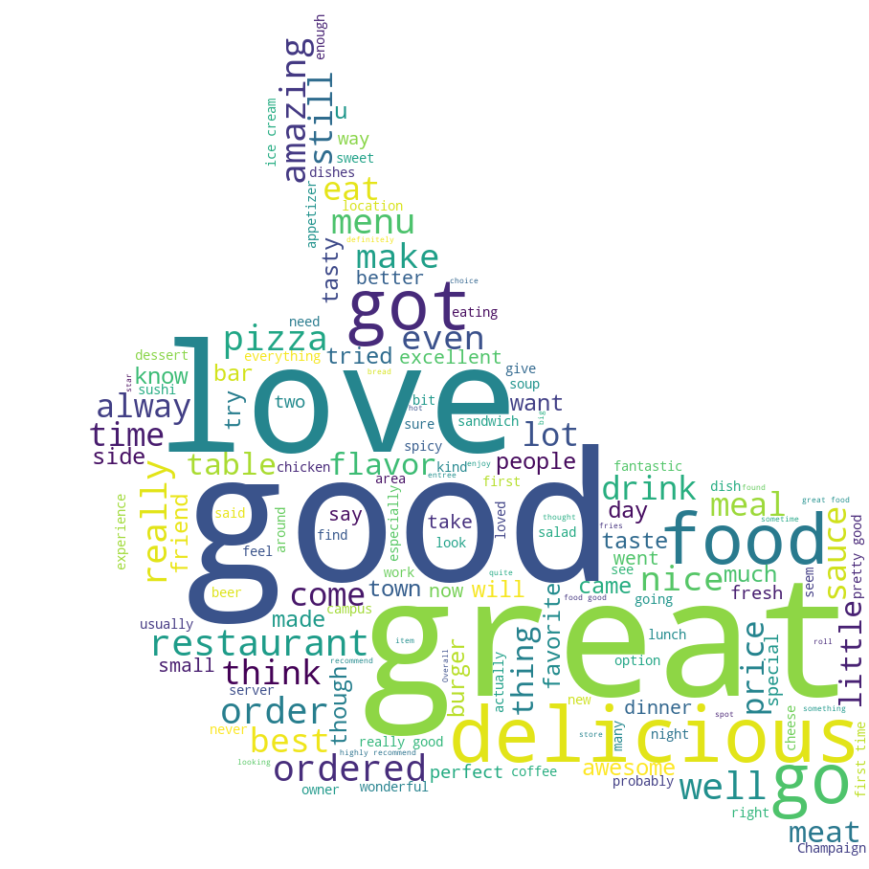
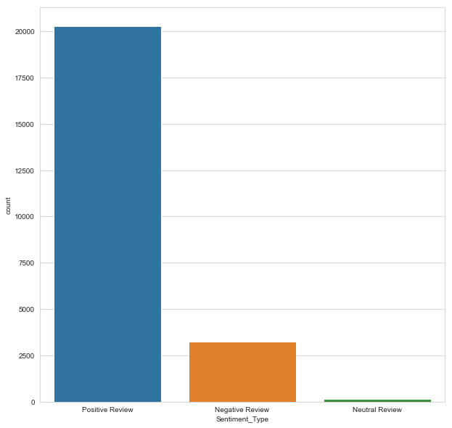
Exploratory Data Analysis
Review:
We have performed sentiment analysis on the review dataset text
People seem to be more likely to write a review for a positive experience than a negative one
Notes:
Using the nltk, we have performed sentiment analysis
Mention there is no empty strings in the text

Slide 11
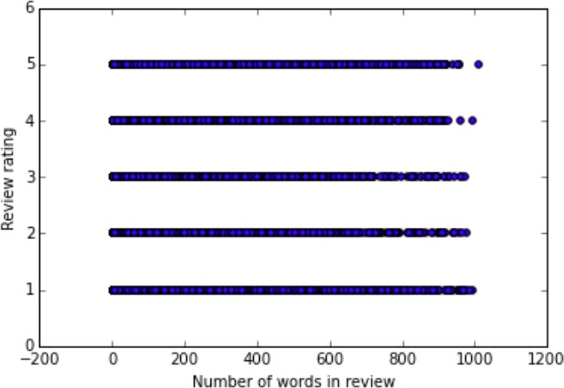
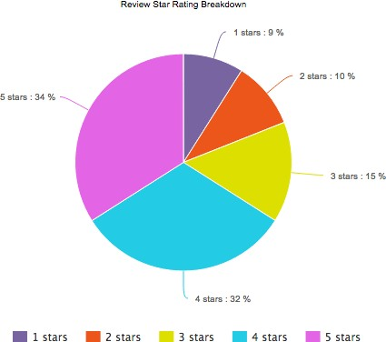
Exploratory Data Analysis
Review:
The yelp reviews dataset consists of ratings provided by the user out of 5 stars.
Most of the users have given more positive ratings to the restaurants.

Slide 12


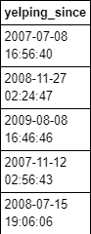
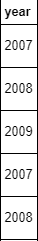
Data Cleaning
Business:
It was found that there are no duplicate entries, as there are no recurring business ids
Spelling correction for the city variable
Standardize the date format of hours variable
Users:
Compute tenure for each user using start year of the user

Slide 13
Data Cleaning
Reviews:
We cross checked the ‘review_count’ variable in the user dataset by aggregating the number of reviews given by each user from the review dataset
We found that 22,836 users have more count of reviews of the aggregated review counts than the given review count.
In review dataset, we found that there were cases where a unique user would rate one restaurant several times throughout his/her history. For such case, we only kept the most recent review since it reflected the user’s latest preference.

Slide 14
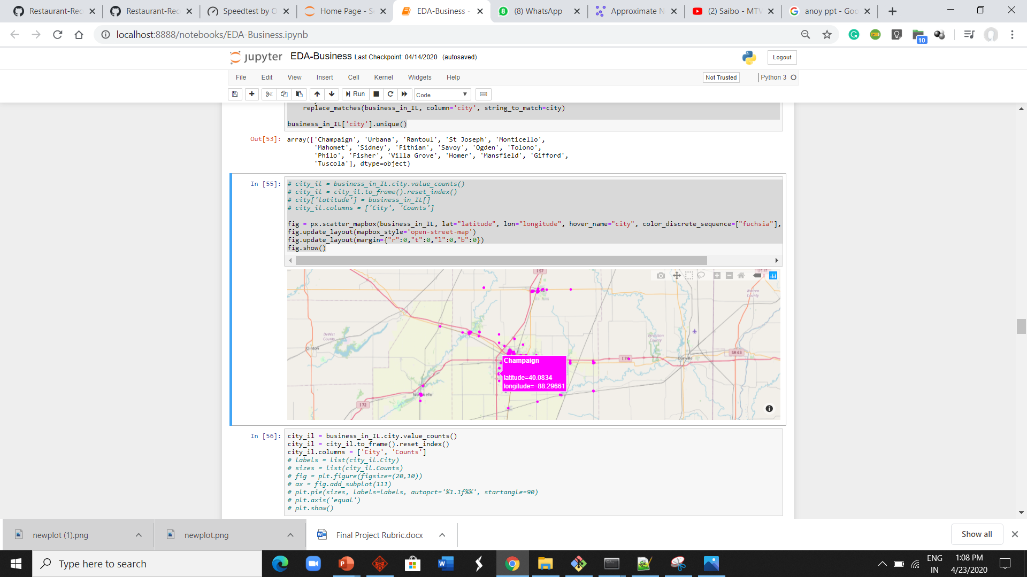
Data Preparation
Business
Businesses with open = 1 tag were only considered
Considered only Illinois-based restaurants in our dataset
Attributes’ column in the dataset was extrapolated to create new features
Out of 436 tags we decided to keep top 60 tags with highest popularities
We have incorporated the median income for each zip code from the secondary dataset
Features considered for the recommender system :-
Number of stars
Review counts of each restaurant
Categories of the restaurants as item features
Median income of the zipcode

Slide 15
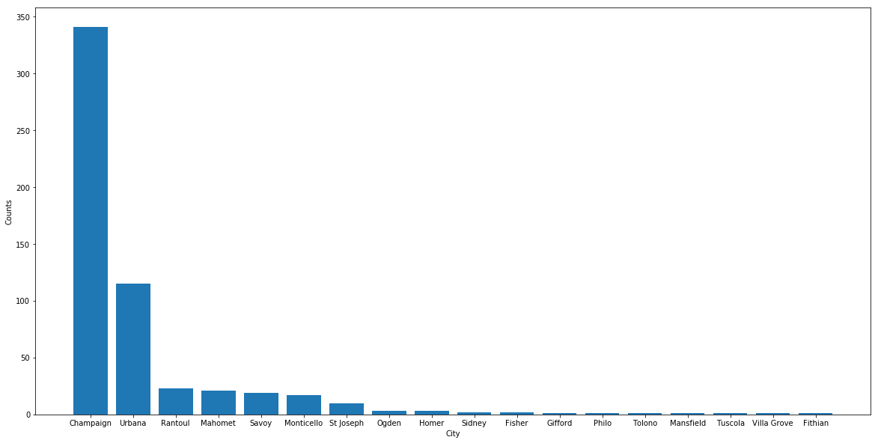
Data Preparation
Business: Distribution of restaurant business in Illinois
Notes:
- We cannot state Illinois exploration in eda, we can call it in data preparation after we have declared that we will be focusing on illinois

Slide 16
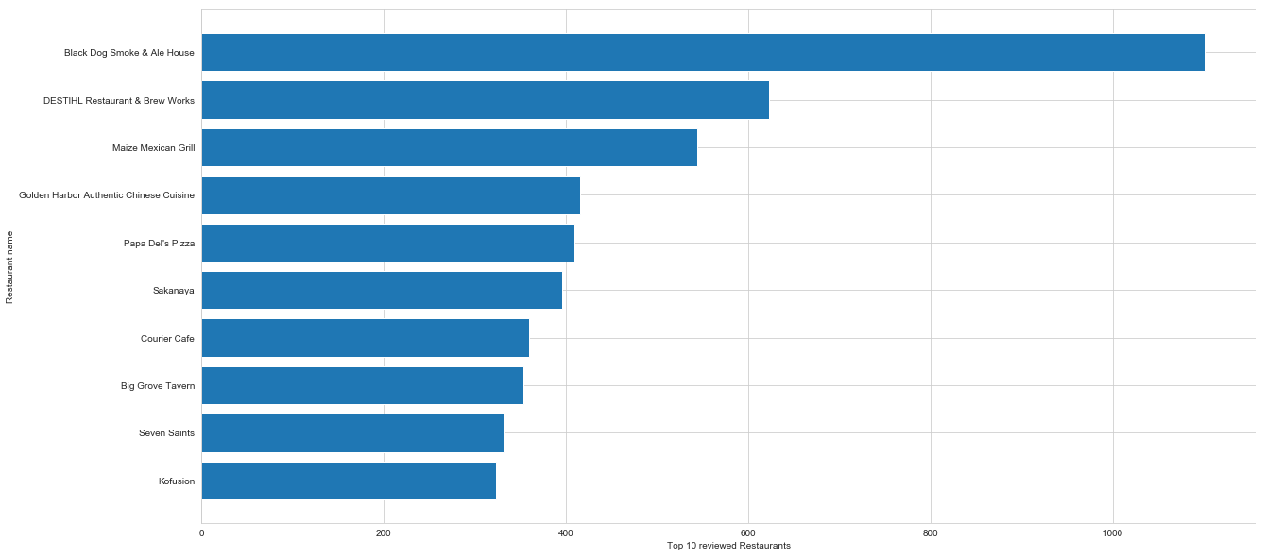
Data Preparation
TOP 10 MOST REVIEWED RESTAURANTS IN ILLINOIS
Notes:
- We cannot state Illinois exploration in eda, we can call it in data preparation after we have declared that we will be focusing on illinois

Slide 17
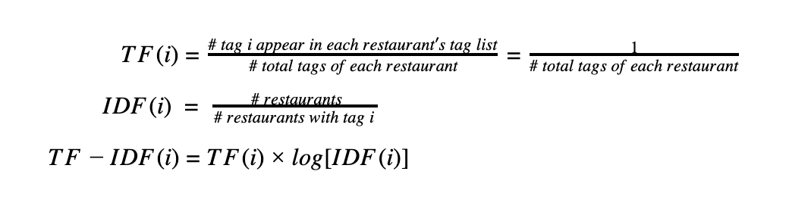
Data Preparation
Review
To remove user biases from the ratings provided by the user, we have standardized the users’ rating by subtracting their mean rating, and converting it to [-1,1]
Users
Computed TF-IDF for each tag which will be used as weights during model fitting
Heuristically we have selected the features from the ‘users’ dataset which are not sparse.
Number of reviews
Number of times the reviews were regarded as useful
Whether the user is active/elite user in Yelp
User’s favorite restaurant category from past interactions
Create Tenure variable for all the users
Notes:
Review
The reasoning for this transformation is that we want to focus more on ranking the user liked restaurants and disliked restaurants in the correct order, rather than predicting user ratings on each restaurant, which would result in high variance over time.

Slide 18
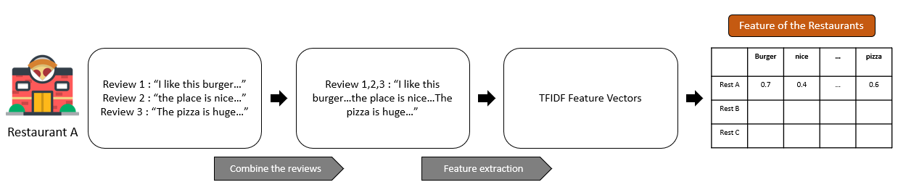
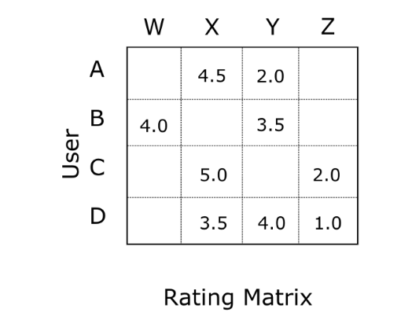
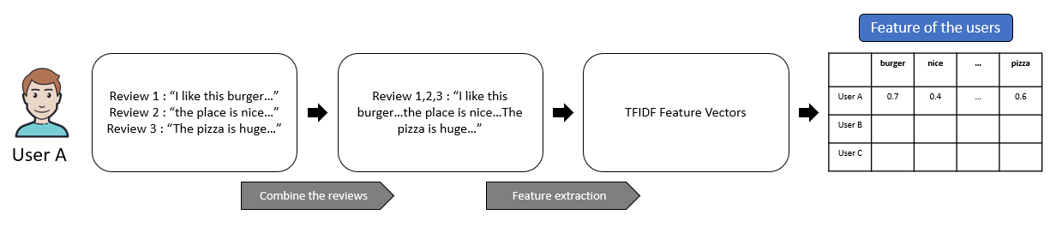
Data Preparation
Interaction Matrix:
Using past interactions recorded between users and restaurants, we create interaction matrix
This helps in detecting similar users and/or Similar restaurants
In our dataset we have large sparsity, which could affect performance of Collaborative filtering
Number of users: 92,381
Number of restaurant: 10,093
Sparsity: 95.6%
Restaurant
Notes:
Review
The reasoning for this transformation is that we want to focus more on ranking the user liked restaurants and disliked restaurants in the correct order, rather than predicting user ratings on each restaurant, which would result in high variance over time.

Slide 19

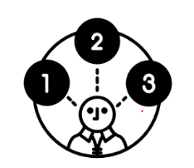
Models
A Recommendation System refers to a system that can predict the future preference of a set of restaurants for a user
Following are the models which we used:-
Approximate Nearest Neighbors
Collaborative Filtering
Hybrid Matrix Factorization
Other models used:
KNN using surprise
Naïve Bayes and cosine similarity
Notes:
We aim to build a personalized prototype of restaurant recommendation system, which not only considers the interaction between customers and restaurants, but also contains metadata representing customers' personal taste and
We didn’t use Content based filtering because it doesn’t consider interactions between users and items which can open up new options for users other than it’s past choices.

Slide 20
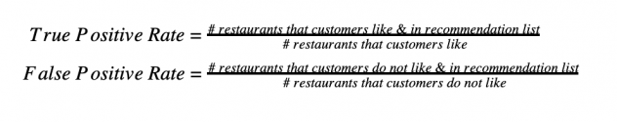
Evaluation Matrix
Train-Test split:
The data is split into train and test, with 20% interactions (6,845) in test and 80% (27,378) interactions in train.
AUC :-
AUC measures the quality of the overall ranking of restaurants recommended to the user.
It can be interpreted as the probability that a randomly chosen positive item is ranked higher than a randomly chosen negative item.
An AUC close to 1.0 will suggest that the provided ordering is correct.
Precision@K :-
Precision@K measures the proportion of positive items among the K highest-ranked items.
Notes:
Positive item – means there is a match between the recommended restaurant and a restaurant liked by the user
https://stackoverflow.com/questions/45451161/evaluating-the-lightfm-recommendation-model

Slide 21
Models
Approximate Nearest Neighbors:-
Retrieves a “good guess” of the nearest neighbor. For that, the algorithm doesn’t guarantee to return the actual nearest neighbor in every case, in order to improve speed or save memory.
An approximate nearest neighbor search algorithm can return points, whose distance from the query is at most c times the distance from the query to its nearest points.
With secondary dataset
Pros
Option to tune hyperparameters to change the accuracy/speed trade-off.
It has small memory usage
 | AUC | Precision
Train | 0.908 | 0.1806
Test | 0.797 | 0.0114
Without secondary dataset
Cons
It does not support GPU processing.
 | AUC | Precision
Train | 0.86 | 0.11
Test | 0.77 | 0.08
Notes:
We have used manhathan disatance as we have high dimensional data
[20:52, 23/04/2020] Rahul Illinois Tech: If you want to place less emphasis on outliers, manhattan distance will try to reduce all errors equally since the gradient has constant magnitude.[20:55, 23/04/2020] Rahul Illinois Tech: The use of Manhattan distance depends a lot on the kind of co-ordinate system that your dataset is using.
While Euclidean distance gives the shortest or minimum distance between two points, Manhattan has specific implementations.For example, if we were to use a Chess dataset, the use of Manhattan distance is more appropriate than Euclidean distance.
Another use would be when are interested in knowing the distance between houses which are few blocks apart.Also, you might want to consider Manhattan distance if the input variables are not similar in type (such as age, gender, height, etc.).
Due to the curse of dimensionality, we know that Euclidean distance becomes a poor choice as the number of dimensions increases.
So in a nutshell: Manhattan distance generally works only if the points are arranged in the form of a grid and the problem which we are working on gives more priority to the distance between the points only along with the grids, but not the geometric distance.

Slide 22
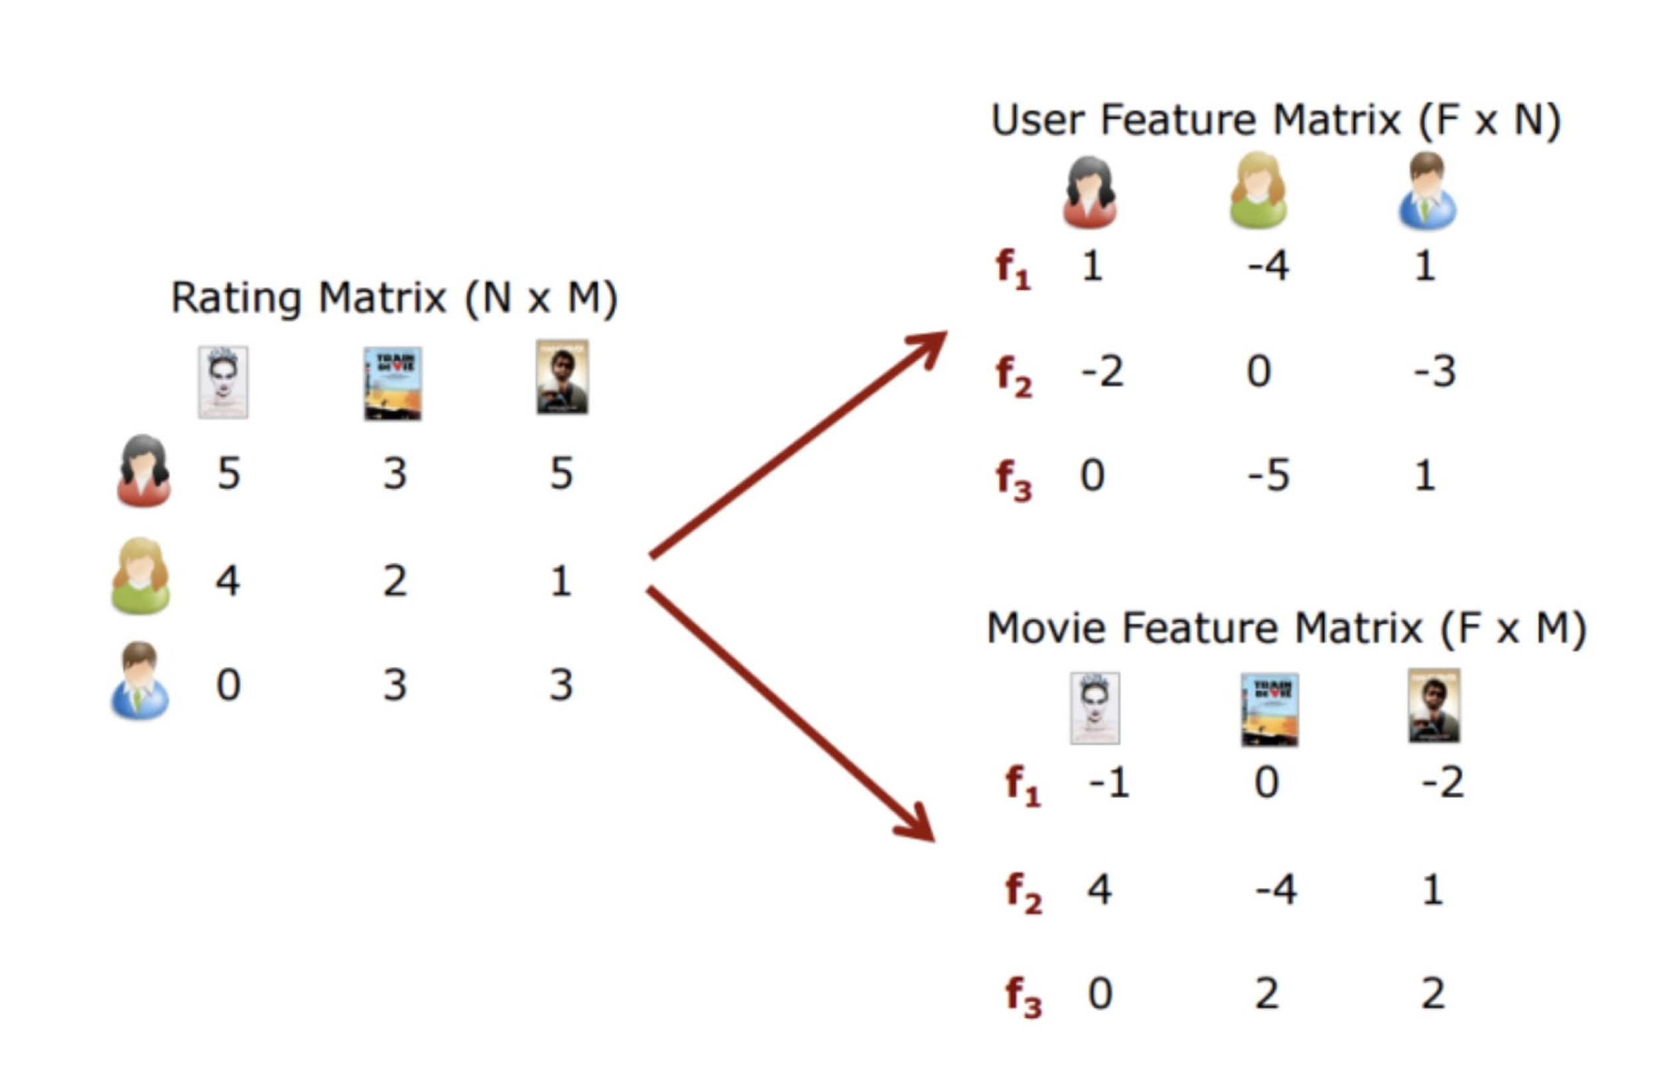
Models
Matrix Factorization :-
Decomposes the interaction matrix into two user and item matrices
The factorized matrices/embeddings have the same number or rows but different number of columns depending on the size of the users or items.
The latent embeddings capture latent features about attributes of users and items

Slide 23
Models
Hybrid Matrix Factorization:-
Hybrid recommender is an advanced kind of recommender that uses both collaborative and content-based filtering for making recommendations.
Hybrid matrix factorization model represents users and items as linear combinations of their content features’ latent factors.
With secondary dataset
Pros
Hybrid matrix factorization model represents users and items as linear combinations of their content features’ latent factors
Able to Handle sparse data.
The model outperforms both collaborative and content-based models in sparse interaction data scenario.
 | AUC | Precision
Train | 0.97 | 0.11
Test | 0.88 | 0.05
Without secondary dataset
 | AUC | Precision
Train | 0.95 | 0.09
Test | 0.86 | 0.05
Cons
Increased processing time

Slide 24
Models
Collaborative Filtering:-
Collaborative filtering incorporates matrix factorization and looks at user/item interactions (visits)and tries to find similarities among the users and items.
Since it sees the interaction between users and items, it opens up new options for users to select from unlike content-based filtering.
Pros:-
Checks user/item interaction matrix and helps finds new options for users unlike content based which recommends on the basis of user’s past history.
No domain knowledge necessary as the embeddings are automatically learned.
Cons:-
Cannot handle new items
Suffers from sparse interaction matrix between users and items
Overfitting
With secondary dataset
 | AUC | Precision
Train | 0.96 | 0.20
Test | 0.80 | 0.03
Without secondary dataset
 | AUC | Precision
Train | 0.90 | 0.18
Test | 0.79 | 0.01

Slide 25
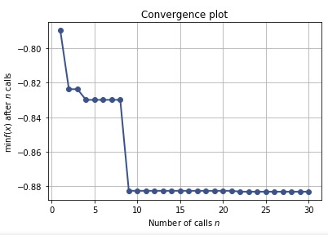
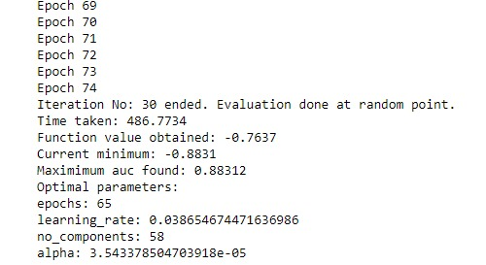
Hyperparameter Tuning
For Hybrid matrix factorization and collaborative filtering, we have found the loss function k-OS WARP gives optimum output
To perform hyperparameters search to obtain the best model we utilized the scikit-optimizer package to search through a range of values for different hyperparameters and evaluated them on mean AUC score
For approximate nearest neighbor, we found Manhattan distance to give optimum results as we have high dimensional data

Slide 26
Results
Hybrid Matrix Factorization gives the optimum results after the hyperparameter tunning
These results are based upon optimal hyperparameters for each model through scikit-optimizer library, which performs cross-validation to find the best set of parameters
Multiple trials were run to account for random noises
Test | AUC | Precision
CF-Train | 0.96 | 0.2
CF-Test | 0.8 | 0.03
HF-Train | 0.97 | 0.11
HF-Test | 0.88 | 0.05
Annoy-Train | 0.9 | 0.18
Annoy-Test | 0.79 | 0.01

Slide 27
Cold-Start Problem
But what if it is a new user?
New users would make the deployed model face “cold start” problem in which the user-item interaction matrix which the model use doesn’t have any data for the new user
In this case, we created a different matrix factorization model using the user and item features and then get the new user’s parsed through which checks for its similarity with existing user and then recommends restaurants

Slide 28
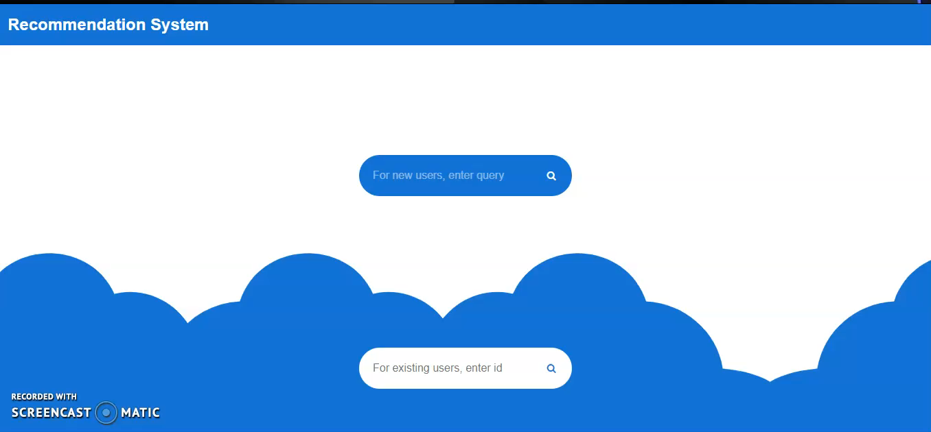
Demo

Slide 29
Lessons Learned
How recommendation systems works using Annoy and LightFM
Web Scraping
Data Cleaning is not easy
Extracting insights from data
Data Preparation
Version Control

Slide 30
Challenges
Sparsity of the data
Trip Advisor data
Working with limited documentation of the recommenders’ system libraries

Slide 31
Future Plans
Location based recommendations
Expand the system for the entire country
Build a complete website for the system
Take user inputs and update the database

Slide 32
QUESTIONS ?

